Slide 1

Anatomy and Psychology of Bug Hunting
By Anthony McKale Associate Director of DevOps and Cloud
Date 12-2023

Slide 2

Disclaimer This talk is based off many previous talks, done at many previous times and place, over many many years THIS TALK IS MIT LICENSED

Slide 3
TABLE OF CONTENTS What: Bugs? BUGS! What: Bug Types When: Bugs Physiology When: Bugs bug
How: verify Bugs
How: fix Bugs

Slide 4
What: Bugs? BUGS!

Slide 5
What: Bugs? BUGS!
Audience participation Question: What are bugs ?

Slide 6
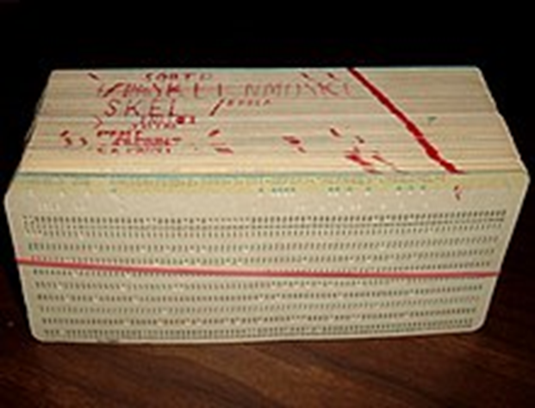
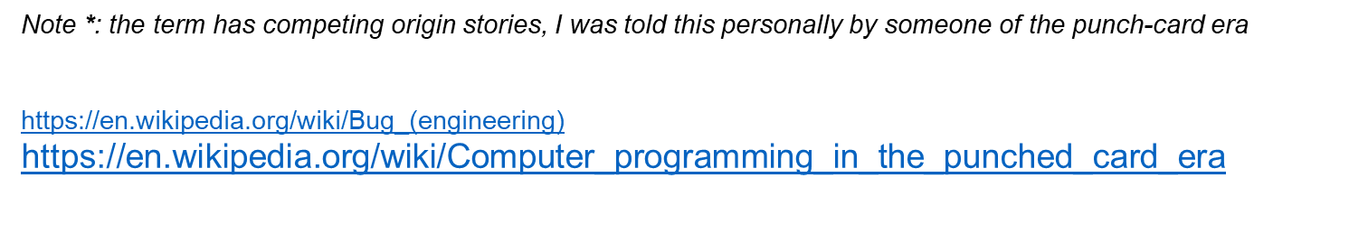
Real Bugs
Used to be paper eating Insects That hid and ate the data storing paper

Slide 7

Software Bugs
Bugs are:
Coding Mistakes
Misinterpreted requirements
Poorly Interacting systems
Misconfigured Servers

Slide 8

Neu Bugs
Audience participation
Question ?
When are bugs not a bug?

Slide 9
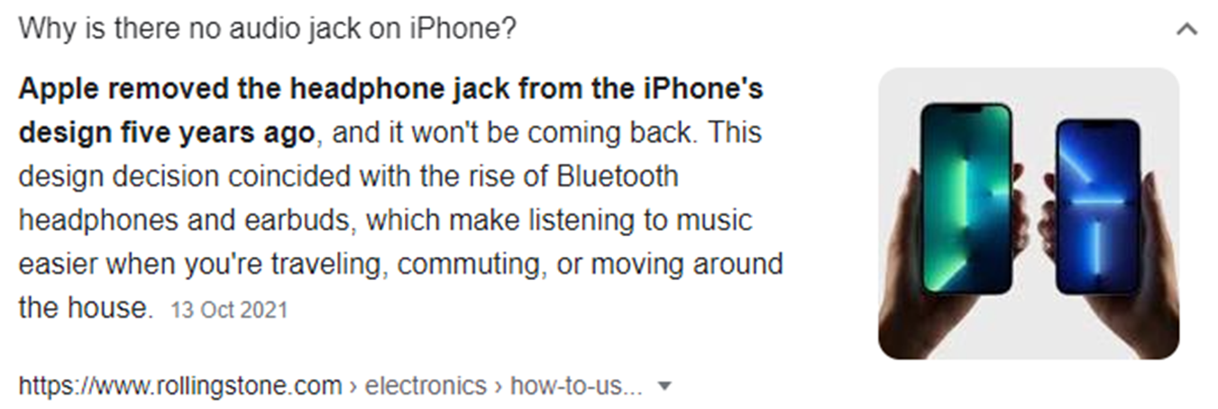
Poor Feature
“It’s not a bug, it’s a feature”

Slide 10
What: Bugs
Types of Bug

Slide 11
Bug Types
Bugs are hard Bug Behavior => get type of bug Bug Type => determines root cause
Root Cause => determines fix
Ps: Always do a post mortem for the big bugs
To prevent future classes of that Bug/Incident!

Slide 12
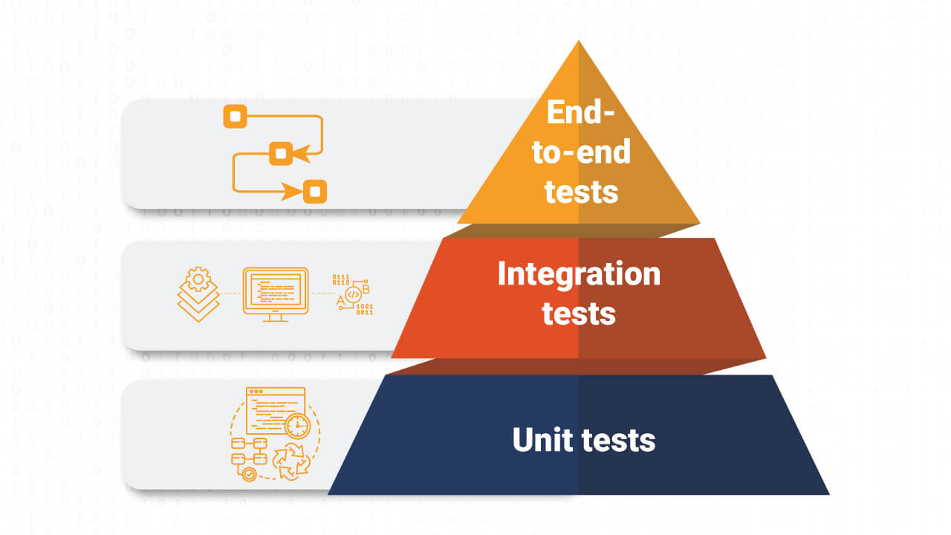
Bug Types
Bug Type => determines correct testing

Slide 13
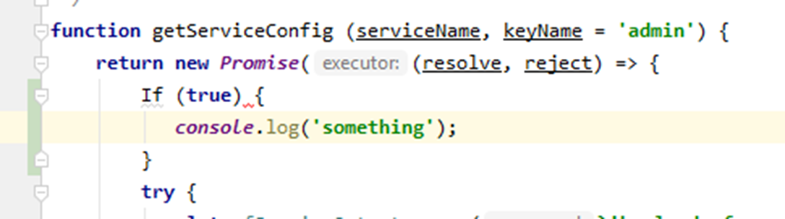
Bug: Compilation
Linting and Synatx errors ! Stopped by: code review / linting Prod?: SHOULD NEVER BE IN PROD Unless different dev/prod interpreter or library version

Slide 14
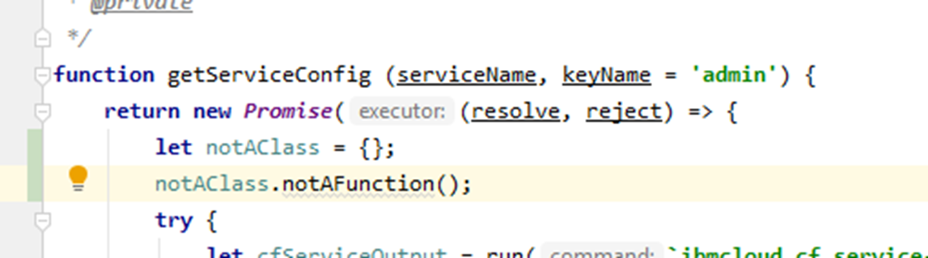
Bug: Runtime
Runtime errors: null pointer / divide by 0 Stopped by: code review / unit testing Prod?: CAN BE ON PROD, SHOULD BE CAUGHT BY TESTING / ALERTING IN LOWER ENVIRONMENTS

Slide 15
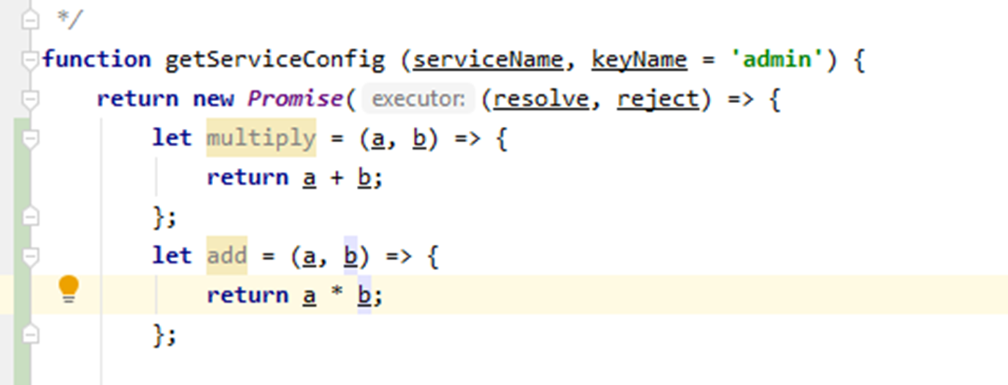
Bug: Logic
Code not working as expected Stopped by: code review / unit testing Prod?: CAN BE ON PROD, SHOULD BE CAUGHT BY TESTING / BUSINESS USERS

Slide 16
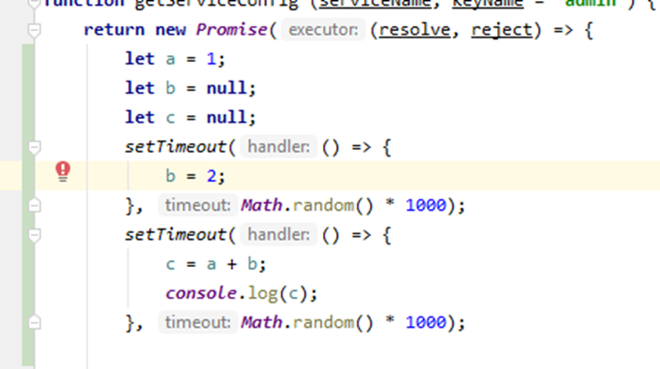
Bug: Race Time
Async timing issues, between 3rd parties or code Stopped by: code review / integration testing Prod?: CAN BE ON PROD, SHOULD BE CAUGHT BY TESTING / BUSINESS USERS

Slide 17
Bug: Race Time
THEY ARE HARD TO DEBUG AS THIS ARE INTERMITTENT BY NATURE AND HARD TO REPRODUCE VIA CODE ! Best detected and reproduced by Manual testers

Slide 18

Bug: Integration
3rd parties configuration or expectations Stopped by: code review / integration testing Prod?: CAN BE ON PROD, SHOULD BE CAUGHT BY INTEGRATION TESTING

Slide 19
Bug: Integration
Warning: hard to spot if dev/test not representative of production
Unlikely to be spotted by unit testing as external dependencies will be mocked out

Slide 20
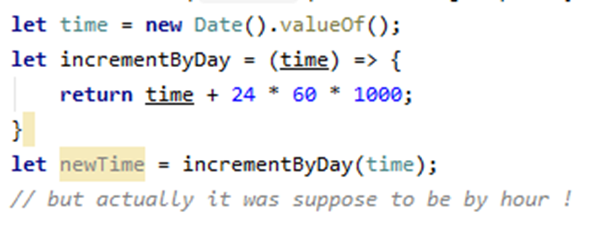
Bug: Requirements
Code correct, specification was not… Stopped by: business testing Prod?: CAN BE ON PROD, SHOULD BE CAUGHT BY SPRINT REVIEWS / CUSTOMER TESTING

Slide 21
Bug: Requirements
Normally due to poor requirements gathering, and quality assurance
Aggravated by Poor communication or misunderstandings between team members

Slide 22
Bug Types
BUG | CAUGHT BY | PREVENT WITH | COMMON PROD BUG?
Compilation | LINTING | CI/CD LINTING | NO
Runtime+Logic | Code Review | Unit testing | COMMON
Race time | Hand Testing | Code Review + Testing | RARE
Integration | e2e Testing | CI/CD e2e Testing | RARE
Requirements | Business | Project Comms | YES…

Slide 23
Bug Types
Onto that certain feeling… Any one who’s personally broken a prod environment knows Bug Physiology

Slide 24
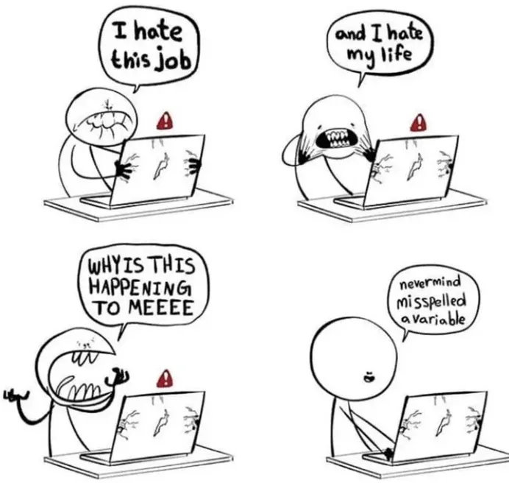
When: Bugs? BUGS!
Bug Physiology

Slide 25
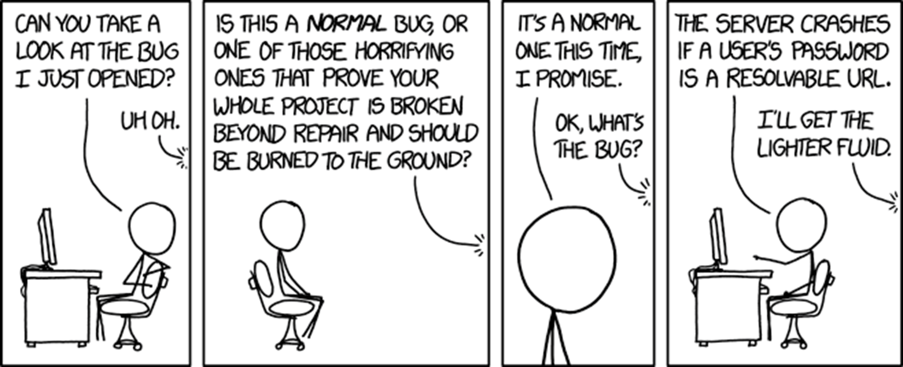
Production Bugs
Production = Scary Picture xkcd

Slide 26
Prod: Incident Example
Steps
Discovery
Reproduce on Dev
Fix in Dev
Reproduce on Test
Fix in Test
Paperwork….
Reproduce on Prod
Fix in Prod

Slide 27
Prod: Real Example
Steps
Discovery
Having everyone and their boss emailing / phone you
Reproduce on Dev
Having everyone and their boss emailing / phone you
Fix in Dev
Having everyone and their boss emailing / phone you
Reproduce on Test
Having everyone and their boss emailing / phone you
Fix in Test
Having everyone and their boss emailing / phone you
Paperwork…
Having everyone and their boss emailing / phone you.
Reproduce on Prod
Having everyone and their boss emailing / phone you
Fix in Prod
Profit ?

Slide 28
Psychology
Serious Bugs produce classic 5 stage grief 1) Denial : it’s not that bad
2) Anger : why the hell did xx not check this
3) Bargaining : maybe if we do xxx no one with notice
4) Depression : were all getting fired
5) Acceptance : tell management we have a problem

Slide 29
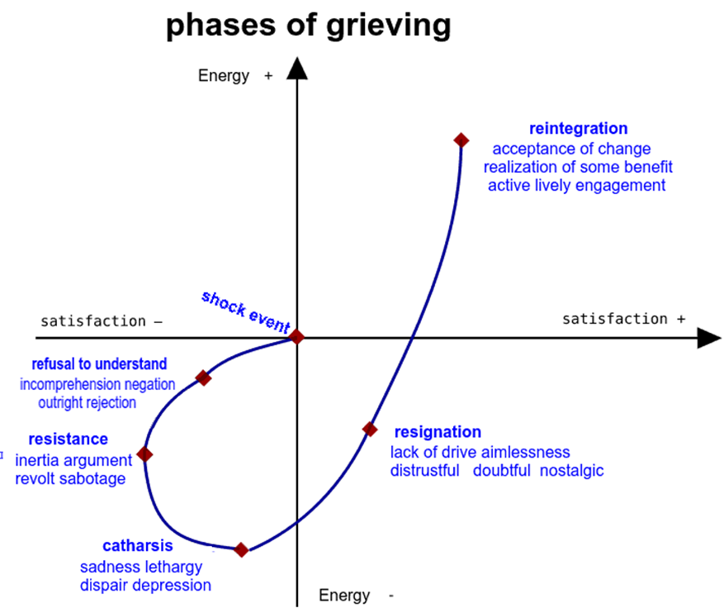
Psychology

Slide 30
Psychology
Serious Bugs are hard to deal with and accept
2 Basic rules to deal with bugs / incidents

Slide 31
Psychology
Rule 1: DON’T PANIC
* maybe grab a towel It’s important to not turtle up, or get overwhelmed at a team or personal mistake

Slide 32
Psychology
Rule 1: DON’T PANIC
* maybe grab a towel It’s important to not turtle up, or get overwhelmed at a team or personal mistake
Rule 2: Communication & Honesty
Report issues immediately
Don’t Hide or Ignore
Don’t dismiss error reports

Slide 33
Psychology
We’ve all been through it
Onto when bugs happen, and what to do about it

Slide 34
When Bugs Bug

Slide 35
When bugs bug
Rules of thumb
Prod bugs more expensive to fix than dev (upto x20 more expensive to fix)
Comms must be clear and efficient (otherwise cost of updates will delay fixes)
Responsibly of team leadership to protect support engineers (helps prevent them being overwhelmed)

Slide 36
When bugs bug
Three common places bugs appear
During development
During Non-Prod Releases
During Prod Releases

Slide 37
When bugs bug
Also for fun
Long after code deployments
(due to data volume or hardware failures)
After 3rd party dependency changes (say the ibmcloud cloud dns changed…)

Slide 38
When bugs bug
.
Time of Bug | Cost | Control Cause
Developer Machine | NONE | Developer YES
Dev | LOW | Testing YES
Prod | HIGH | Testing YES
External factor change | MEDIUM | Infra QA YES
3rd party change | HIGH | 3rd Party NO

Slide 39
When bugs bug
Cliffnotes:
Prod Release bugs are normally a failure of testing
regression test after release
re-test features after release
post mortem after serious incidents

Slide 40
How: Verifying Bugs

Slide 41
Steps of Verification
Places bugs hide
Config == EASY
Code == HARD
EXTERNAL == VERY HARD

Slide 42
Steps of Verification
Cliffnotes:
Search + Google
Check code
Check environments + external
Get Help… quickly

Slide 43
1) Search for Error
First, look for Configuration / Library / simple issues
Step 1: Enter the bug in your case tracking system
Step 2: Google the error message
https://sites.google.com/site/yacoset/Home/how-to-fix-bugs-step-by-step

Slide 44
2) Verify Code
Second, look for code issues
Step 3: Identify the immediate line of code where the bug occurs
Step 4: Identify the line of code where the bug actually occurs
Step 5: Identify the species of bug
Step 6: Use the process of elimination
Step 7: Log everything and analyse the logs

Slide 45
3) External Stuff
3rd and lastly drill into the external stuff
Step 8: Eliminate the hardware, 3rd party vendor Step 8: Eliminate the hardware or platform as a cause
Step 9: Look at the correlations

Slide 46
4) Get Help
Cliffnotes:
Search + Google
Check code
Check environments + external
Get Help… quickly
Lastly in-depth how to fix bugs…

Slide 47
Cliffnotes
LASTLY … DON’T PANIC, GET HELP
Step 10: Bring-in outside help Aka another colleague
QUICKLY!

Slide 48
How: Fixing Bugs

Slide 49
Fixing Bugs
This is the easy part “Use the verification steps to see what is wrong and JUST fix it”
The best bugs are the ones that never get to prod control the release risk!
“Just: The Most Dangerous Word In Software Development”
https://alistapart.com/blog/post/the-most-dangerous-word-in-software-development/

Slide 50

Questions ?
Notes:
Vision film
This is about ambition.
An ambition to improve.
This is about change.
A change to the way things are done.
This is about technology.
Technology that makes brilliant ideas happen.
This is about desire
A desire to stay ahead and succeed.
We know every client is different.
That every challenge is different.
We’re here to harness technology.
To extract maximum value from data.
To navigate complexity.
To secure the right outcome.
Across sectors.
Across the world.
Across every project.
Again and again and again.
Whether building a single click.
To search a million documents.
Or connecting hundreds of data points.
To accelerate decision making.
This is transformation.
Planned right.
Designed right.
Built right.
And delivered right.
This is transformation secured.
That makes brilliant ideas happen.
In the right way.
Welcome to 6point6.
Transformation secured.
Architecture | Cloud | Data | Engineering | Cyber security.

Slide 51
Thank you for your Awesomeness
If you have any questions anthony.mckale@6point6.co.uk #dep-eng-devops (slack)

